Slide 1
Project Title:-
Cataract Detection Via classification

Slide 2
GROUP MEMBERS
Ayesha Fatima MS-81
Aliya Zafar MS-75
Irrum Shafique MS-81

Slide 3
Research Problem
Cataracts are a major cause of blindness which results in opacification of lens.
From literature we found that Several systems were proposed for detection of cataracts or lens opacity LOCS-,LOCII,LOCSIII.
The proposed methods were grading based and need subjective analysis approach.

Slide 4
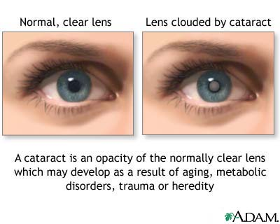

Slide 5
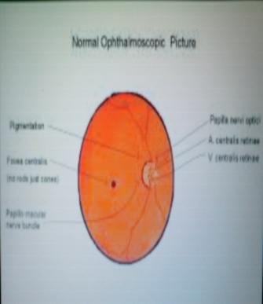
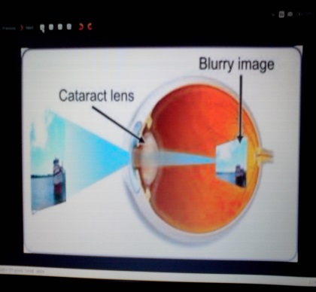
Normal and Cataract image
Normal
Cataract image

Slide 6
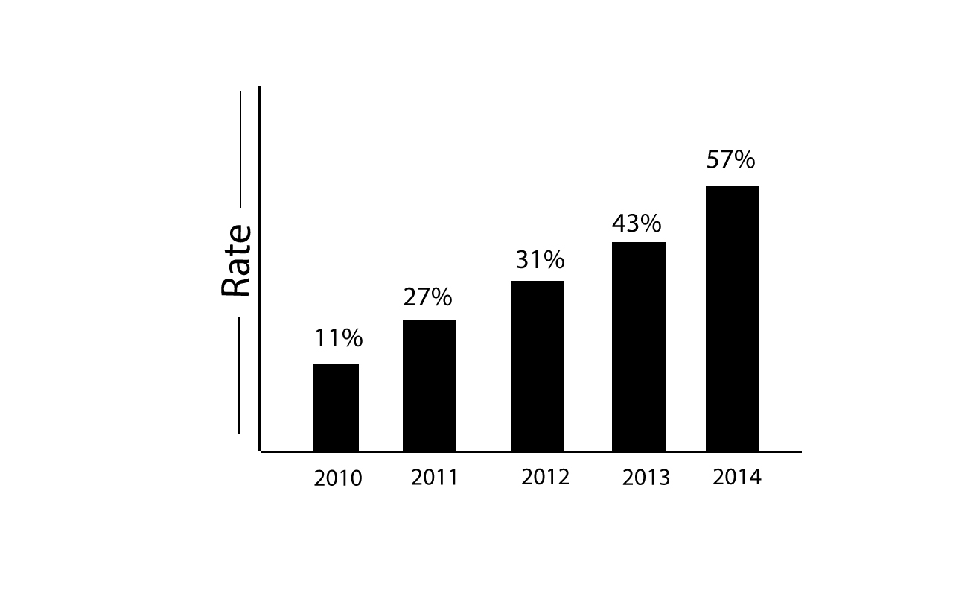
Motivation
Almost 50% of people over the age of 40 years in Asia are suffering from cataract disease or vision fading, which are growing drastically in world. the conventional methods needs heavy equipment and consultants our proposed algorithm is robust and provide effective and quick detection of cataracts

Slide 7
Scope Of Research
A better approach towards detection and classification of cataracts.
Color Based Features
Better Classification
Robust Algorithm

Slide 8
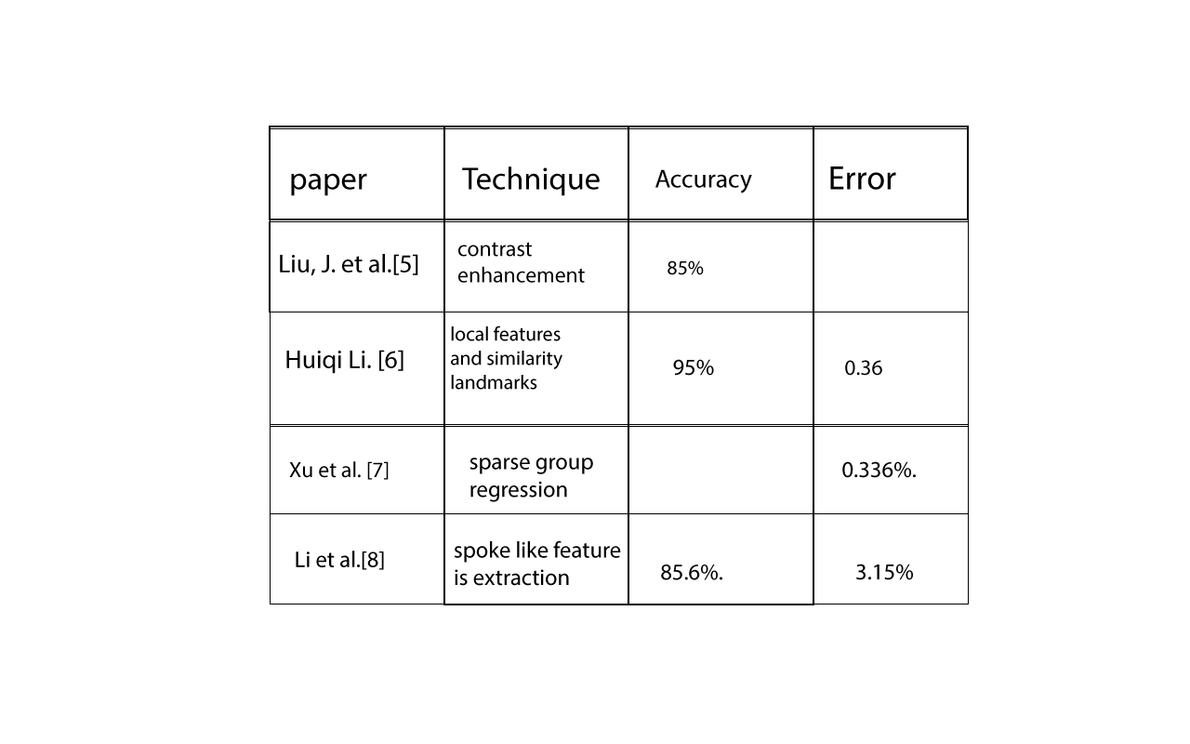
Literature Review:-
:

Slide 9
Methodology:-
Our method consists of three stages
Preprocessing
Feature Extraction
Classification

Slide 10
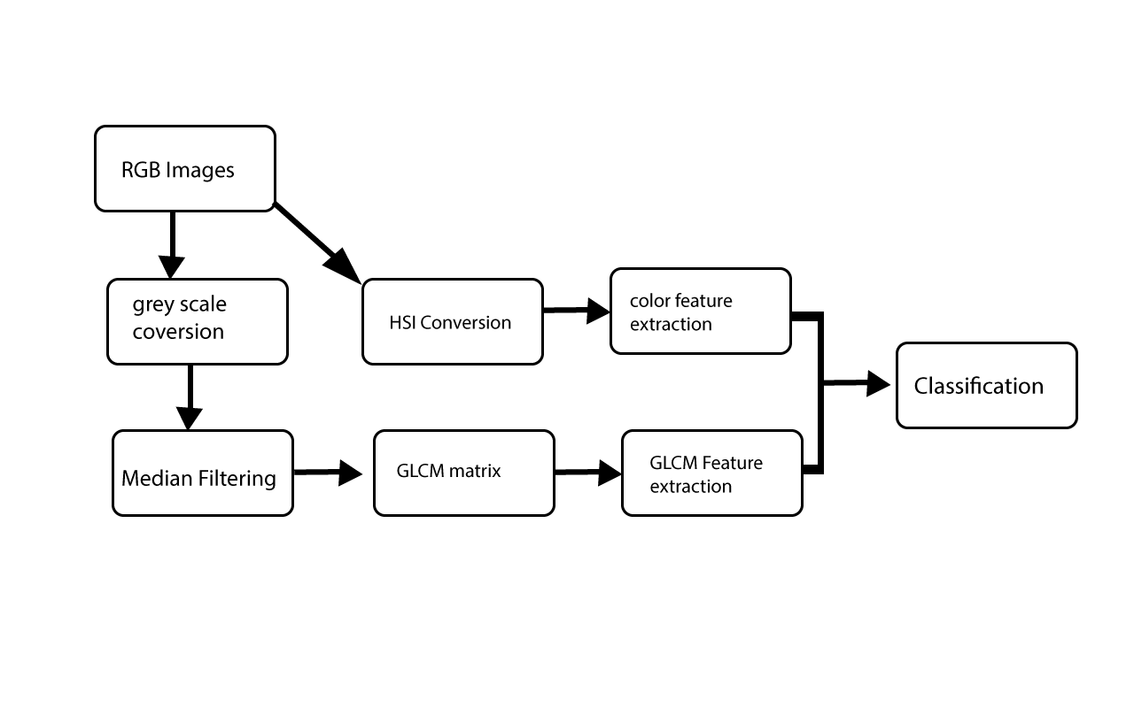
Flow diagram
,

Slide 11
Preprocessing:
ROI detection
Segmentation
Convert RGB image into gray scale
Apply median filter

Slide 12
Feature Extraction:
Feature extraction is the procedure that takes out the hidden properties of the image
GLCM based Feature
HSI Color Space Feature

Slide 13
GLCM for Feature Extraction:
For GLCM the most common statistics
Energy
Contrast
Correlation and Homogeneity

Slide 14
Feature Extraction Using HSI
Mean Hue,
Mean Saturation,
Standard Deviation (SD) Hue,
SD Saturation,
SD intensity

Slide 15
Classification:-
Four different types of Classifier
SVM
Naïve Bayes
K Nearest Neighbor (KNN)
Decision Tree

Slide 16
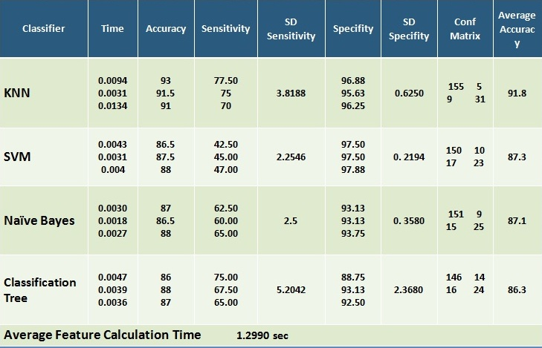
Results:-

Slide 17
Limitations:-
Raw Data
No Standard resolution
Preprocessing
Accuracy

Slide 18
Conclusion:
Performances of Different classifier as diagnostic tools to aid physicians in the detection of cataract even at the early stages.
classifiers are also suitable for diagnosing the effectiveness of cataract
The accuracy of these tools depend on the size and quality of the training
The KNN classifier is effective to the tune of about 91.8% accuracy.

Slide 19
Future work
This algorithm provide basic foundation
Efficient and robust work
Now classified data is available for further processing.

Slide 20
References
Yuen J, Li Y, Shapiro LG, et al. Automated, Computerized,Feature-Based Phenotype Analysis of Slit Lamp Images of the Mouse Lens. Experimental eye research 2008;86(4):562-575. doi:10.1016/j.exer.2007.11.019.
Huiqi Li; Joo Hwee Lim; Jiang Liu; Mitchell, P.; Tan, A.G.; Jie Jin Wang; Tien Yin Wong, "A Computer-Aided Diagnosis System of Nuclear Cataract," Biomedical Engineering, IEEE Transactions on , vol.57, no.7, pp.1690,1698, July 2010
Huiqi Li; Liling Ko,; Joo Hwee Lim; Jiang Liu; Wong, D.W.K.; Tien Yin Wong, "Image based diagnosis of cortical cataract," Engineering in Medicine and Biology Society, 2008. EMBS 2008. 30th Annual International Conference of the IEEE , vol., no., pp.3904,3907, 20-25 Aug. 2008

Slide 21


Slide 22


